Slide 1
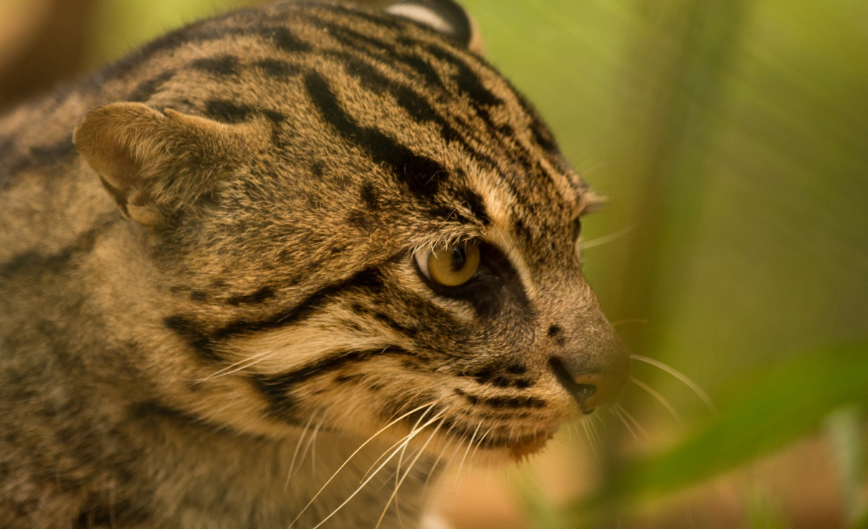
Fishing cat (Prionailurus viverrinus) conservation and population monitoring in hill country Sri Lanka
Ashan Thudugala
University of Peradeniya,
Sri Lanka

Slide 2
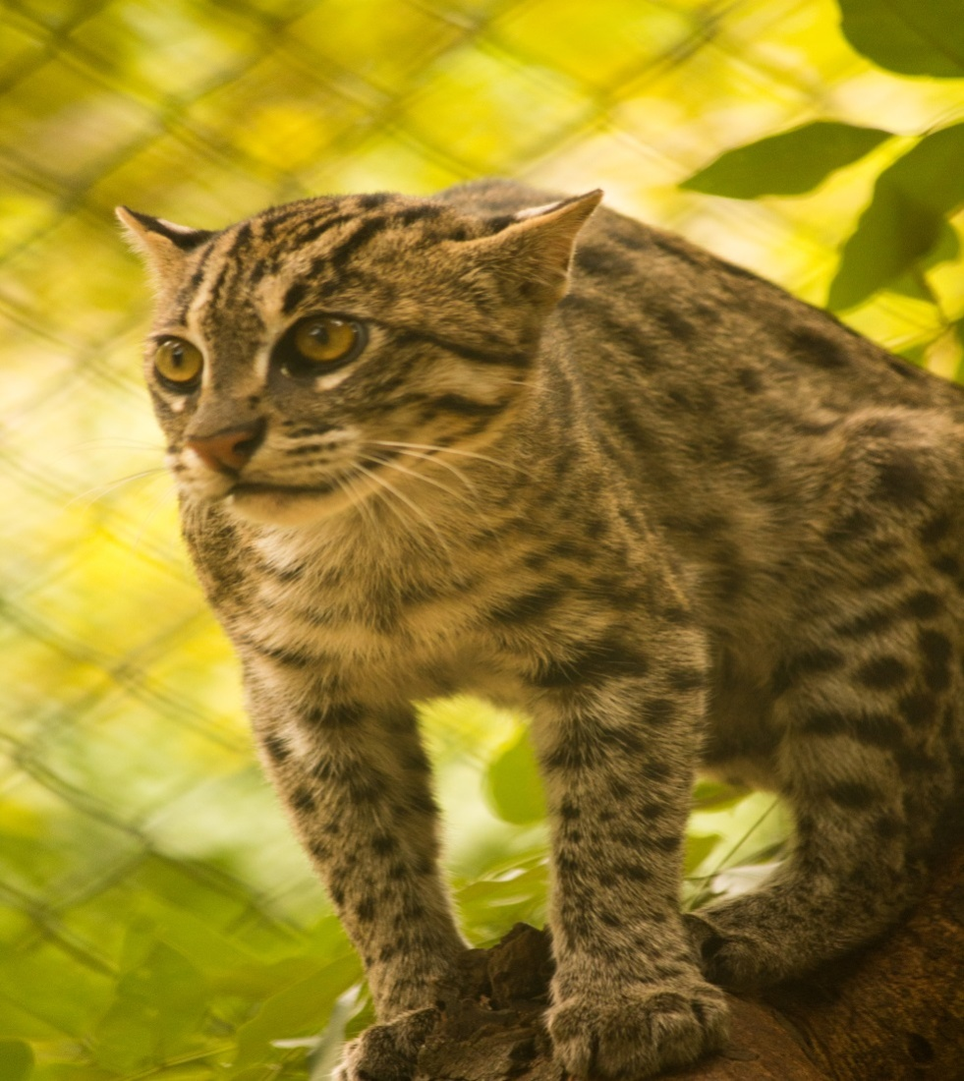
Fishing cats, Who are they?
A medium sized wild cat
Found in South and Southeast Asia
IUCN red list - Endangered
Commonly associated with water rich habitats
In Sri Lanka – hill country forests

Slide 3
Main Objectives
To initiate conservation practices to conserve fishing cats
To monitor fishing cat distribution and population in hill country- Sri Lanka

Slide 4
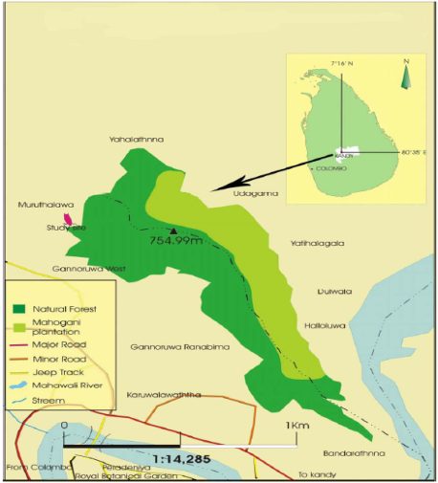
Study site
Gannoruwa forest reserve
Altitude:-550m-580m
Mean temperature:-24.1ºC
Mean annual rainfall:- 2131 mm
Forest type:-Semi-evergreen forest

Slide 5
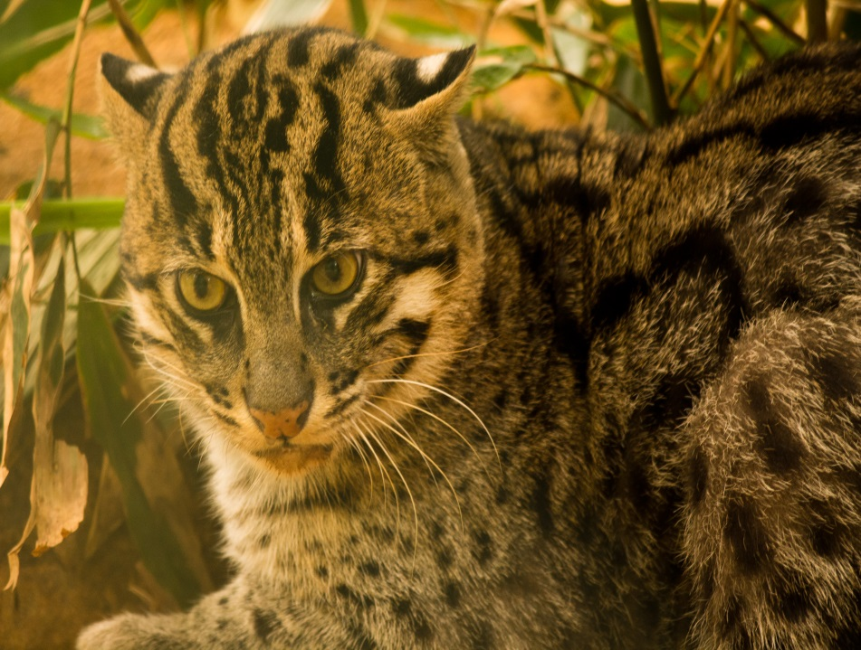
Why are fishing cats important?
Top predator in some habitats
Flagship species
Small in number
Threats they face
Endangered species
Conservation actions

Slide 6
Presence is detected by…
Direct evidences :
Camera trapping
Scat collection
Pugmark census
Indirect evidences:
Veterinary records of the area
Road kills and other deaths
Interviewing villagers

Slide 7
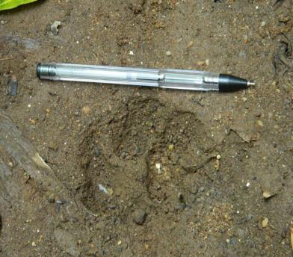
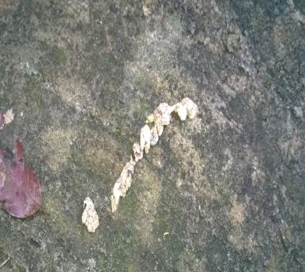
Some direct evidences
Pugmark of a fishing cat
Scat of a fishing cat

Slide 8
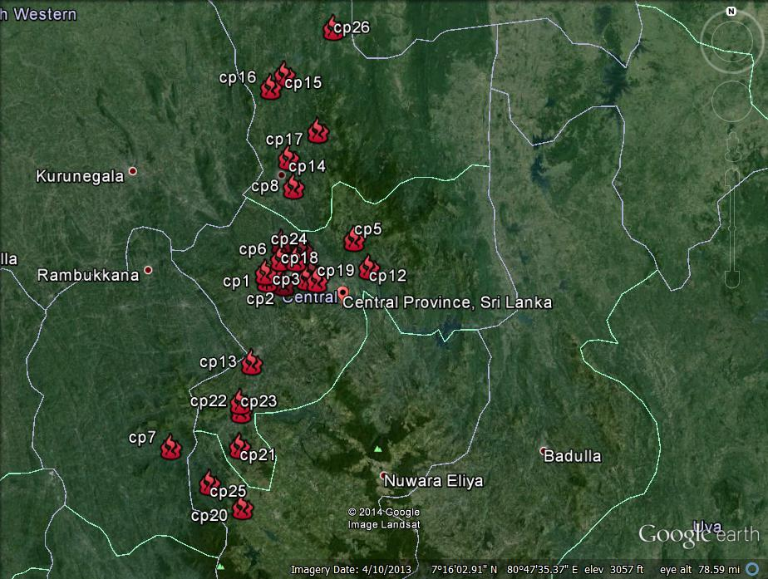
Distribution
25 locations were identified in 4 different districts within the hill country area
Mathale
Kandy
Kegalle
Nuwara Eliya

Slide 9
Threats they face
Habitat loss
Road kills
Poisoning
Poaching
Electric fencing
Kill for fur and indigenous medicine
Special cases in Sri Lanka

Slide 10
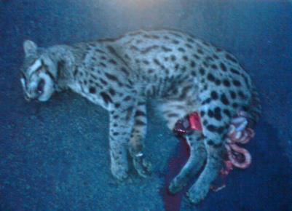
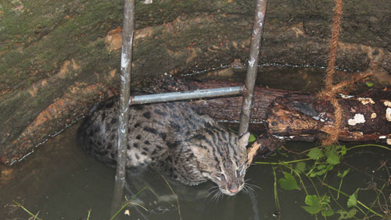
Threats they face in Sri Lanka
Corpse of a fishing cat due to a road kill
A fishing cat dropped in to an agricultural well

Slide 11
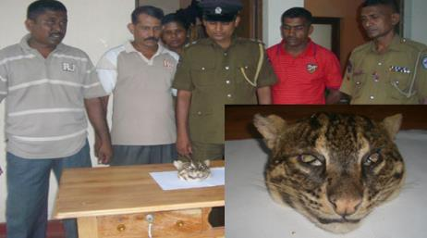
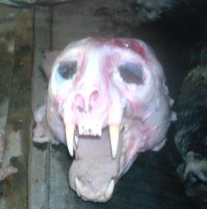
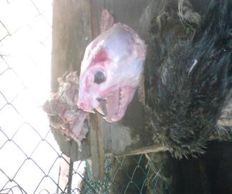
Threats they face in Sri Lanka
A head of a Fishing cat, caught by police department during an investigation
Skulls of Skinned fishing cats for fur

Slide 12
Conservation goals
To conduct Awareness programs to educate students and villagers
To make new rules and regulations
To take actions to minimize the mortality rate
To take actions to human wildlife conflict
To care and rare little kittens and wounded animals
.

Slide 13
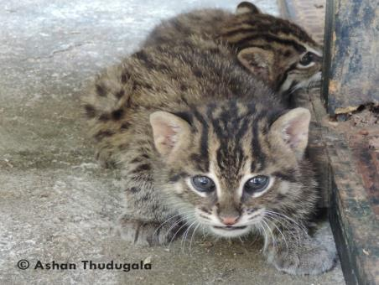
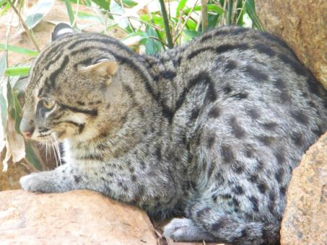
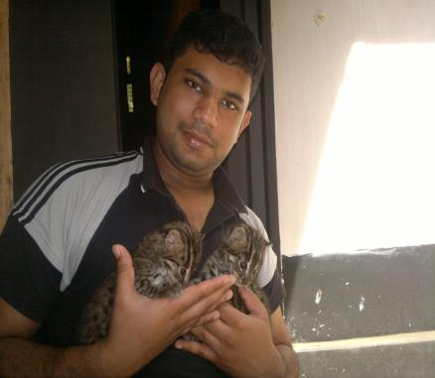
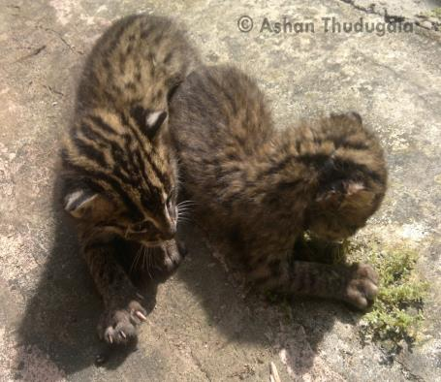

Slide 14
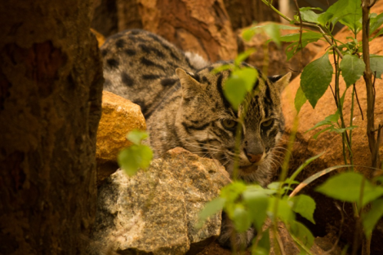
Towards Conservation

Slide 15
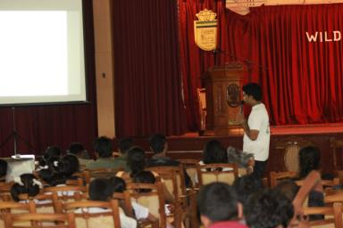
Small cat - Work shop
One day workshop for school children about small cats in Sri Lanka
Objectives : To educate school children about small cats and how they can contribute towards conservation

Slide 16
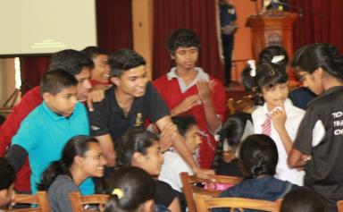
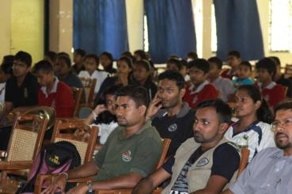
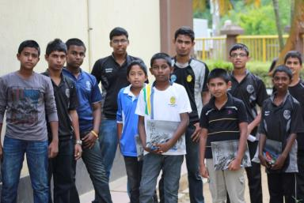
Work shop memories…

Slide 17
Fishing cat- youth camp
Targeted for 20 selected University students
Objectives :
To educate the students in value of conservation
To gain experience and field knowledge
To promote conservation and awareness of wild cat species of Sri Lanka

Slide 18
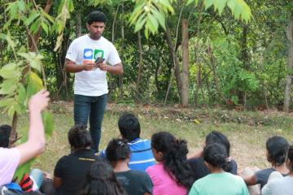
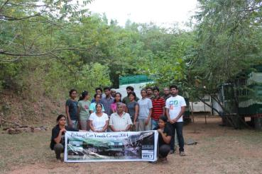
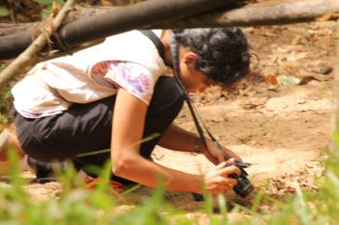
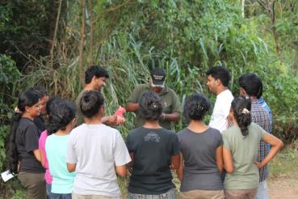
Fishing cat youth camp memories…

Slide 19
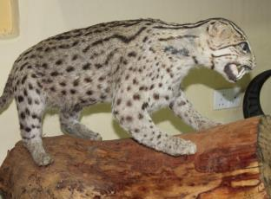
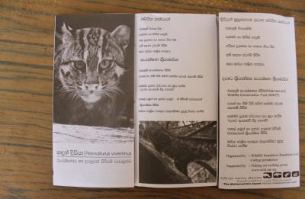
Public awareness program
Conducted in Sarasaviuyana Science Exhibition held on 28th to 30th of June
People were educated on life history and conservation strategies of small cats
A stuffed specimen of a fishing cat
A leaflet on fishing cats

Slide 20
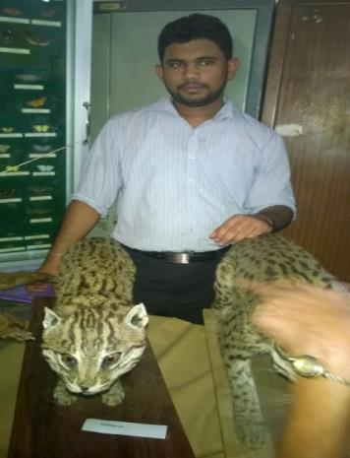
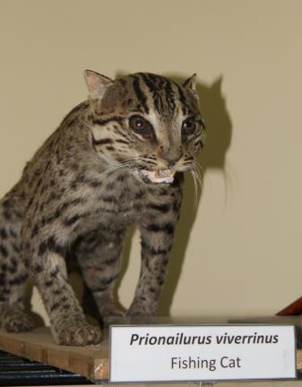
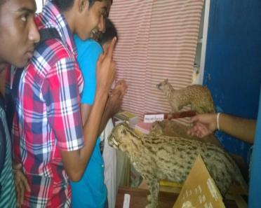

Slide 21
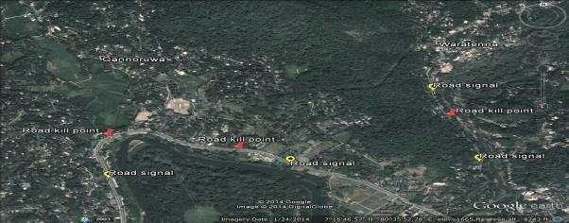
Road signals…
Locating road signals throughout the country
Proposed road signal for fishing cats
Location of road signs

Slide 22
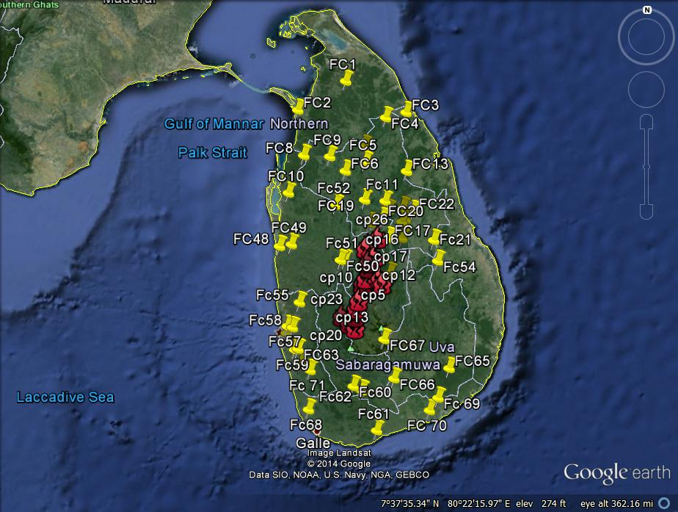
Niche modeling of fishing cat
72 records throughout
Sri Lanka
Modeling using : ArcGIS and MODIS NDVI software

Slide 23
Future Plans

Slide 24
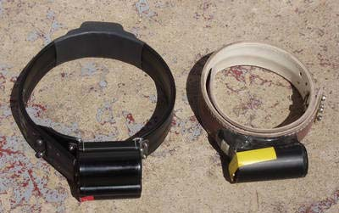
Future plans
Locating road signals throughout the country.
Conducting more awareness programs for school children and villagers.
Monitoring their home ranges and behavior by using radio collars.

Slide 25
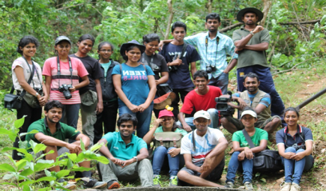
Future plans
To create a small group who are willing to contribution towards fishing cat conservation
To care and rare wounded cats, kittens and relocate them to their original habitats
Proposed team for further programs

Slide 26
Special thanks to…
Dr James Sanderson ; IUCN cat specialist group, Fishing cat working group
Prof. K .B Ranawana ; Department of Zoology University of Peradeniya
Mr. Samitha Harischandra ; Wildlife Research and Conservation Trust
Mr. Gajaba Ellepola ; Department of Zoology University of Peradeniya
Mohamed Bin Zayed Species Conservation Fund

Slide 27
THANK YOU
SCARED..LOST.. AND SO LONELY..YOU ARE OUR ONLY HOPE

